Slide 1


Los Altos High School
School Counseling Department
Notes:
Ariel
-welcome parents to the evening

Slide 2
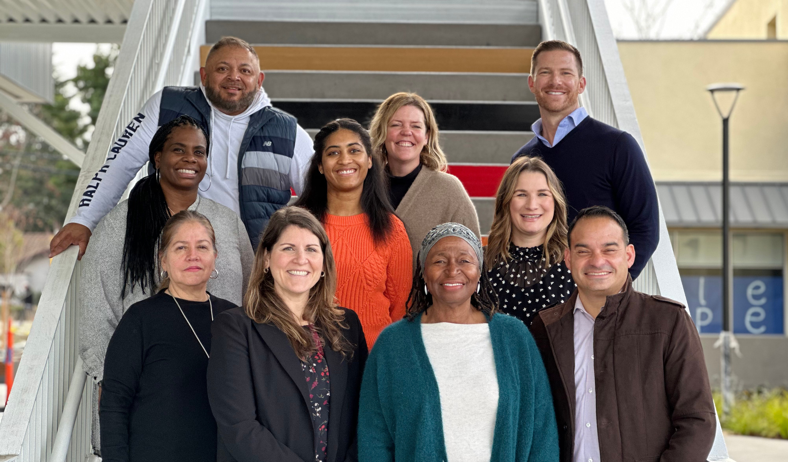
LAHS School Counseling
who we are
Notes:
Tamesha
-Brief description of team e.g. 7 counselors, 2 C&CC advisors, etc, location, drop in times, etc.
-Start quick round of each person introducing themselves
1) Name
2) Years as School Counselor
3) Favorite thing about being i this profession.

Slide 3

LAHS School Counseling
what we are all about
Balance
Self-Advocacy
Engagement
Collaboration
Personal Growth
Communication
Notes:
Ryan

Slide 4
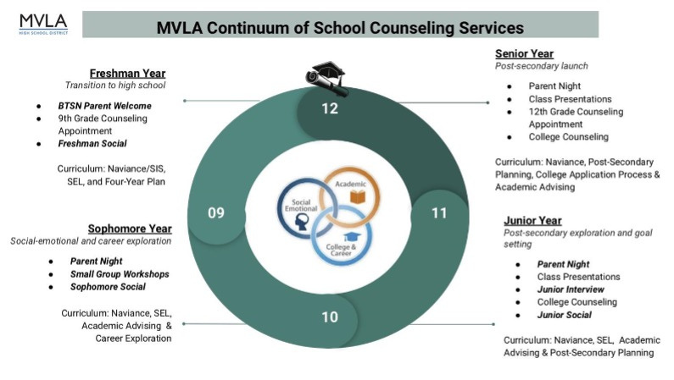
LAHS School Counseling
how we will support your student
Notes:
Deanna

Slide 5



LAHS School Counseling
how you can support your student
Encourage Engagement
Utilize Resources
Offer Support
Notes:
Jenny & Jacob

Slide 6

LAHS School Counseling
where to find additional information
LAHS School Counseling Website
Questions?lahs.counseling@mvla.net
Notes:
Jeamice

Slide 7

LAHS School Counseling
Notes:
Jeamice

